Slide 1
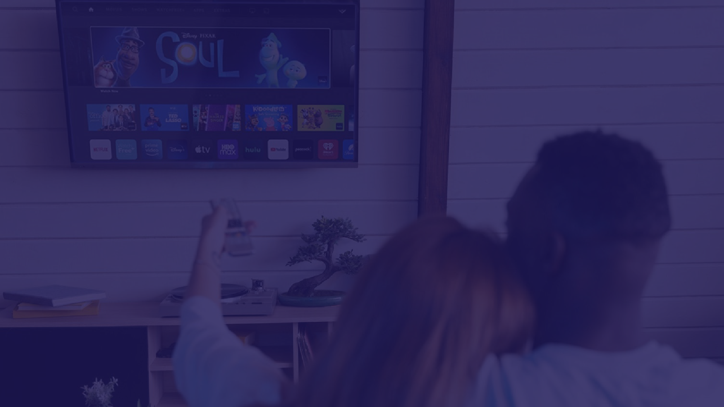
Taking the World by Quantum Advertising!
09/2023

Slide 2
2. WHAT IS STANDARD TODAY?
1. WHY
11. COMPARISON TO NOW
10. EXECUTIVE TEAM
11. OFFER
12. USE OF PROCEEDS
14. TIMELINES/PROJECTS
13. CONTACT
3. PROBLEM
4. SOLUTION
Table of Contents
5. PRODUCT
6. WATCH VIDEO
7. MOBILIZATION PLAN
8. COMPETITVEADVANTAGES
9. MARKETINGSTRATEGY
10. OPPORTUNITYHIGHLIGHTS

Slide 3
Confidentiality Statement
The information in this document is confidential to the person or entity to whom it is addressed and should not be disclosed to any other person or entity. It may not be reproduced in whole, or in part, nor may any of the information contained therein be disclosed without the prior consent of the Company which is being featured in this document. A recipient may not solicit, directly or indirectly (whether through an agent or otherwise) the participation of another institution or person without the prior approval of the directors of the Company which is being featured in this document. The contents of this document have not been independently verified and they do not purport to be comprehensive, or to contain all necessary information to make a decision

Slide 4
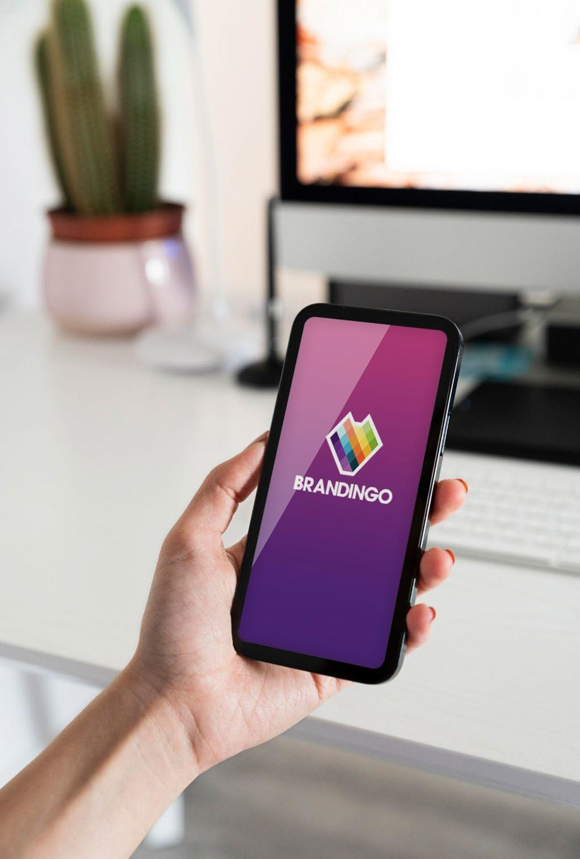
WHY BRANDINGO
Getting conversion is key to the success of brands participating in Branded Advertising through Entertainment. Or at least, it should be.
Partnering with Brandingo enables Brands to communicate with their fans seamlessly with direct, personalized offers sent through our Brandingo App. We take the guesswork out of whether or not your ads reached their target audience with measurable ROI that only Brandingo can deliver.
Don’t leave money on the table when you can unlock it with our app
We are developing an industry disrupting standard in the marketplace to enable direct purchases and interactions with your audience without friction.
4

Slide 5
What Companies Are Using Now
Branded Entertainment through content has been held in a non - conductive trench of traditional advertising for the past 70 years.
Currently, Brands are forced to use limited and expensive commercials to reach their audience. Sometimes, visible QR codes are being used when streaming television is paused but it requires the audience to do something. Our silent audio code is the answer!
Evolving the way Brands can orbit Content, whether live or recorded, is the way forward to a more holistic and enjoyable viewing experience for audiences which creates a curiosity to know more about the products advertised.
5

Slide 6
Problem
Commercials and product placement have no way to convert these expensive advertising placements into sales so they can track what worked and what did not work. Additionally, audiences want personalized ads 24/7, fast service, and to feel powerful in the process - they matter!
Brands will live or die depending on the audience’s perception of them.
According to a recent Statista survey, 51% of respondents, said they were bothered by ads that were not relevant to them… Consumers truly want useful advertising and clear, relevant RTB, in other words, something they can act on.
6

Slide 7
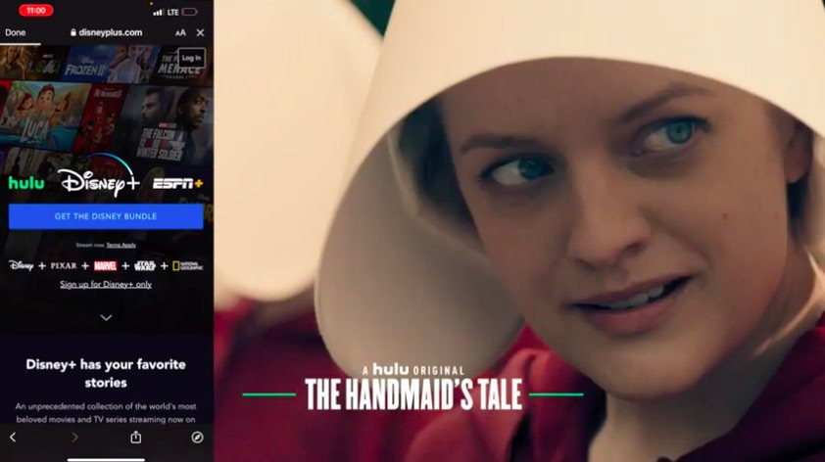
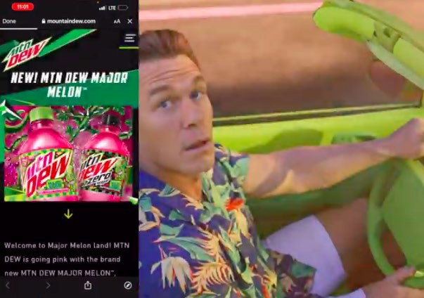
Solution
Direct market to your target audience with our “silent audio watermark” technology that allows your content to be stored on an audience’s mobile device until the person has time to look at the captured ad.
This revolutionary technology will change how audiences receive ads and how brands monetize. No longer will there be a guessing game on what worked and what didn’t. With our unique marketing measurement analytics, everyone knows what works.
Audiences value their time as more important than money these days. Endless interrupting ads frustrate audiences if they are in the middle of a show.
7

Slide 8
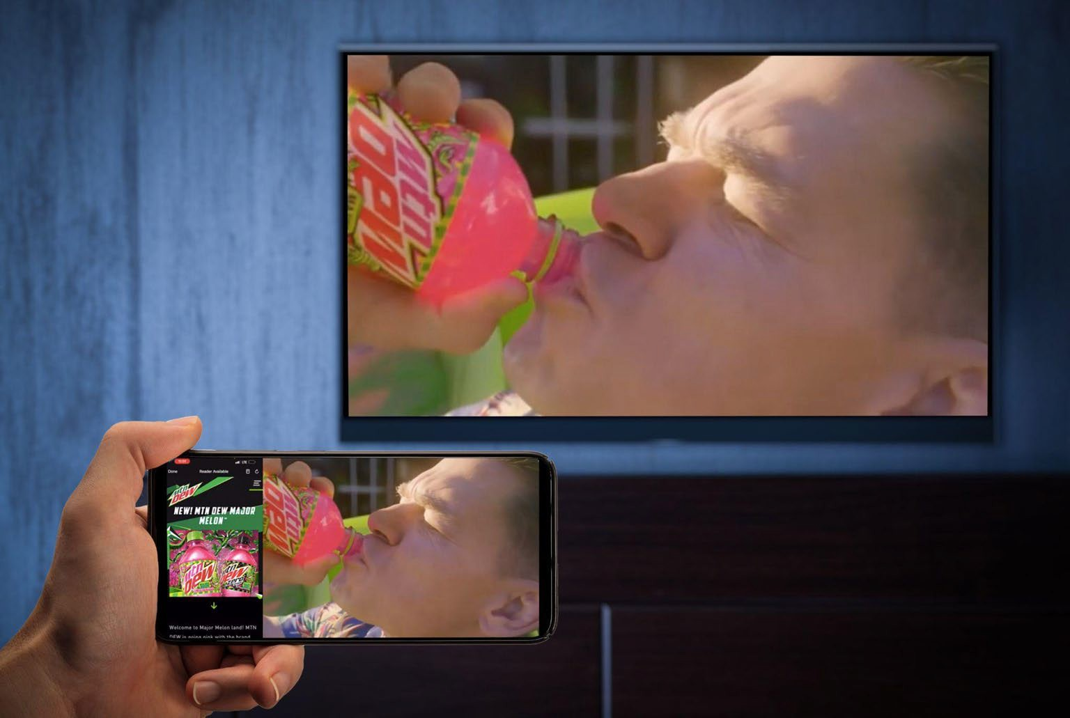
Product
Brandingo is a “meta app” because it is a lifestyle app that brings audiences in alignment with direct interaction and purchases through content without interruption.
8

Slide 9
Click to Watch Video
9

Slide 10
Mobilization Plan
Theatrical
Streaming
Our proprietary technology catapults the revenue streams that can be generated on these industry sectors
Sports
Online
Music
Gaming

Slide 11
COMPETITIVE ADVANTAGES
Industry Experience: Our 25+ years of experience in entertainment business dealmaking. We work in the Entertainment Industry, so our friends are our sales targets for this innovation.
Marketplace: Enhance the deal flow process; streamlines the sale between audiences and brands/ brands and content.
Using AI at key touch points in our software design, we can match the best placements and ads to content and commercials based on price, territory, term and type.
Smart contracts using blockchain technology, we can close in real time with stakeholders on a private ledger. Deals are live in real time, payouts to stakeholders are in real time. Web3 allows us to offer audiences greater flexibility on purchases.
Facilitate direct buys without “googling.” Download songs without iTunes. We utilize the benefits of digital marketing by bringing it into traditional advertising.
Superior Technology: Combining seamless, touch-less technology through our BRANDINGO app, we know this is the opportunity many have dreamed of, but few have realized in our industry.
11

Slide 13
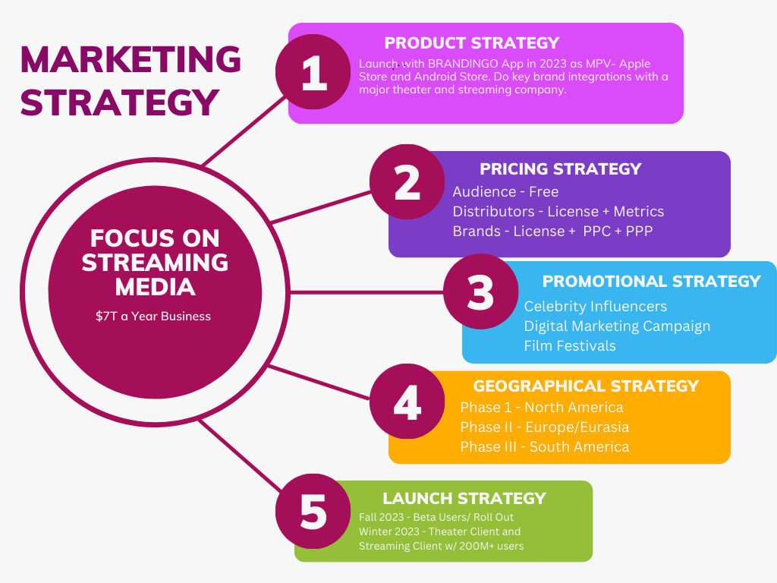

Slide 14
OPPORTUNITY HIGHLIGHTS
Antiquated Current Marketplace : Lacks the real time ability to buy products from content without searching on internet. Limits in current environment to big
Studios : Democratizing brand integration deals and allowing new faces in content participate in these deals. Limits in current environment to big brands; however, with this technology, we can bring in new and emerging brands that afford the deals.
Audiences are bored : Passive viewing with interrupting commercials creates irritation with audiences, but with our app there is no interruption and audiences enjoy the “finds”. Audiences need incentives to buy: Audiences can buy in real time by not having to hunt for the product, plus we give discounts and crypto as a reward for viewing and buying through the app.
Limited ability to track sales : With our app, we can track buyer behavior, purchases, brand popularity, and give ecommerce to every streaming platform that allow them to compete directly with the Amazon marketplace, but virtually.
Untapped revenue streams : Our technology is disruptive to the marketplace of branding in content; thereby, causing new revenue streams and business deals to be created due to the large amount of money being transacted.

Slide 15
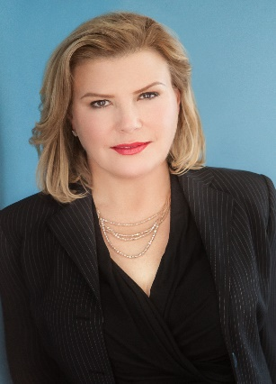
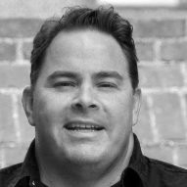
The Executive Team
CEO/Founder: Stephanie Weier is an entrepreneur, technologist, and producer. In 2001, she founded The Domain Group Inc., an entertainment industry research, branding and placement company, which has executed more than 5,000 product placement and branding deals. Brandwood Global was co-founded with her late husband who created the first IMDB system while at Universal. She is a studio veteran from Universal Pictures, she began marketing at the cross-studio marketing efforts on such films as The Flintstones, Casper, and Backdraft.
She has worked on major feature films including Kill Bill, Terminator 2, Crazy Stupid Love, That Awkward Moment and The Social Network. Ms. Weier holds a degree in Intellectual Property and Cyberlaw from Concord Law University, and a Master’s degree in education.
President: Todd Bulgarino co-founded Solutions Management Group in 1996 and later founded techoptions in 2001. Both enterprises provide business-to-business technology solutions. Successful implementations included General Electric, Wells Fargo, TRW, Deutsche Bank, TDS, U.S. Cellular, HGTV, YUM! In 2011, Bulgarino joined DPG as EVP and is currently CSO for the LA based start-up, Brandwood Global. In this leadership position, he collaborates on product development, application testing, education, and solution adoption.

Slide 16
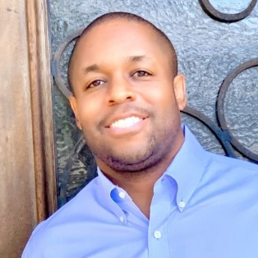
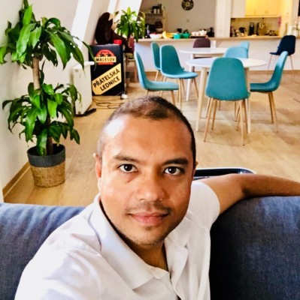
The Executive Team
Temp COO/Advisor: Raymond (Ray) has more than 17 years of experience as a senior management executive and consultant leading global organizations ranging from small businesses, startups, and large enterprises. Ray has held various senior executive positions with companies such as Verisign, Neustar, State Farm Insurance, TeleSign, UltraDNS and has served in an advisory role for several start-up companies in Silicon Valley, Los Angeles, and Washington, DC.
Acting CTO: Amit Rathore has partnered with Brandingo App development with his Awake.VC venture company and his e-commerce software called Shoptype. An innovator, Amit has built several apps in the e-commerce space include the Staples App. He has had successful exits and devotes his time now to a decentralized private equity multiverse. Joining with our startup, Brandingo will become inter-connected into this new e-commerce world of creating influencers out of everyone.

Slide 17
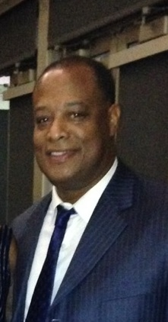
The Executive Team
Temp CFO: Financial professional with 30+ years of a production career distinguished by consistent top-ranking performance’s in generating, growing, creating, initiating new entrepreneurial business', inaugurating and managing new start-ups, asset management for private bank clients. Patrick offers the added value of cross-functional management qualifications and proven leadership talents in the Entertainment and Financial arenas.

Slide 18
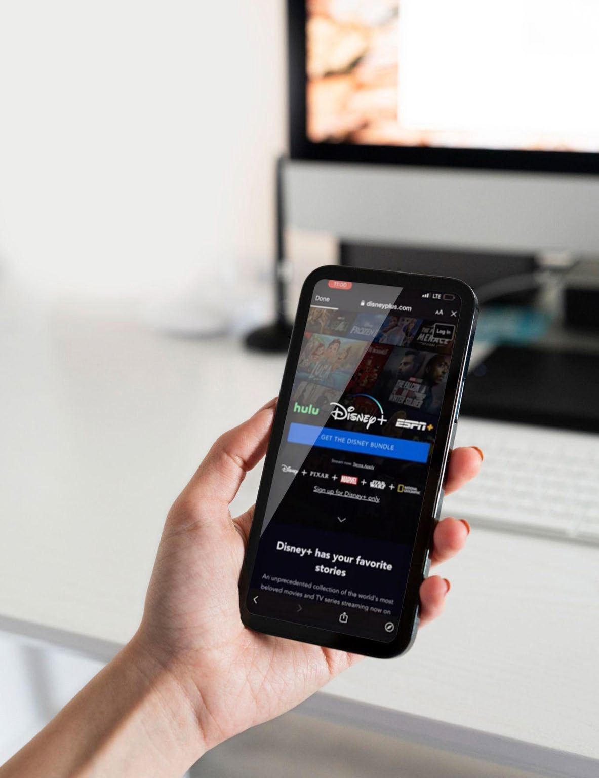
Offer
$2m seed funding to close (SAFE round)
Investor will receive discounted share purchase with valuation at Series A round.
We would like to offer you an opportunity to invest with Brandwood Global to launch our new Brandingo App
10

Slide 19
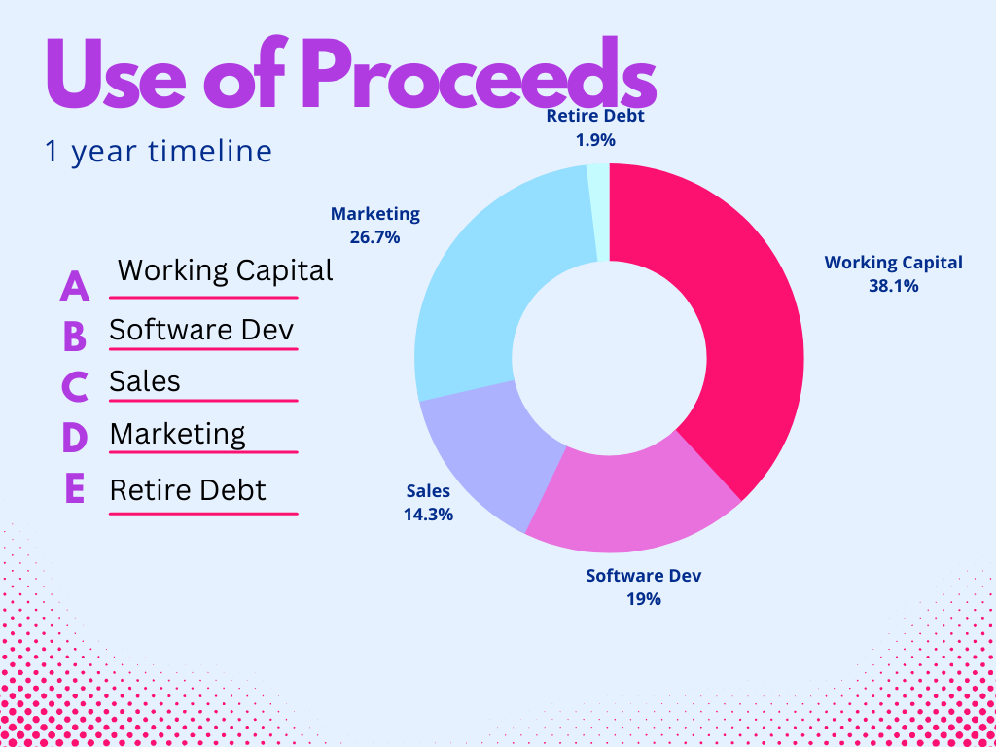

Slide 20
Contact
Stephanie Weier CEO/Co- Founder Brandwood Global, Inc.
CEO@Brandwoodglobal .com
15

